Slide 1
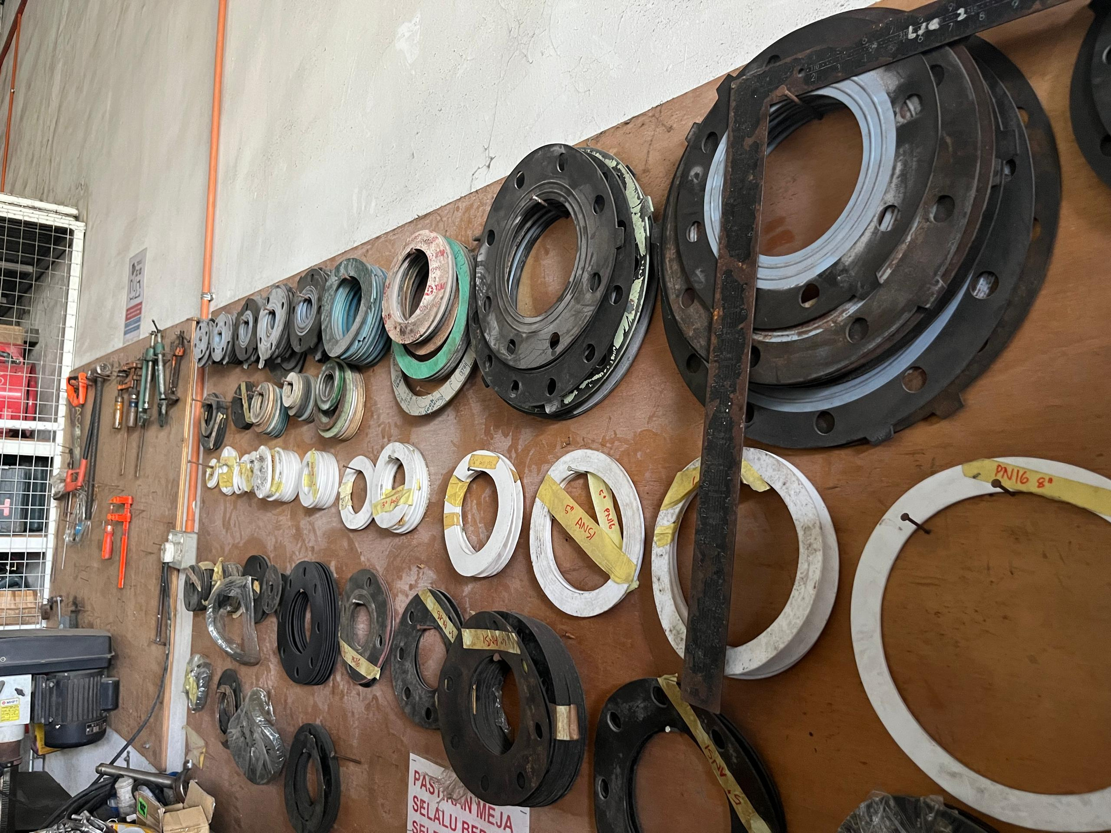

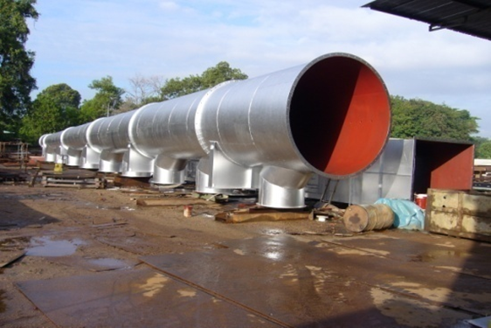
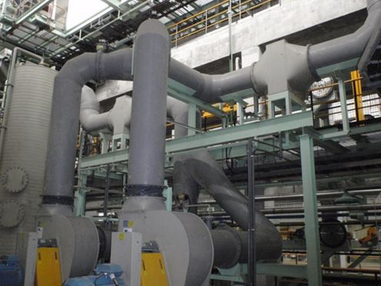
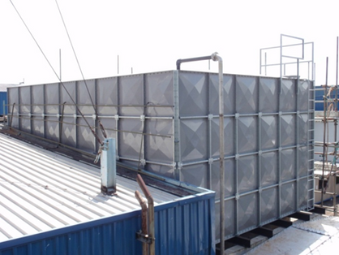
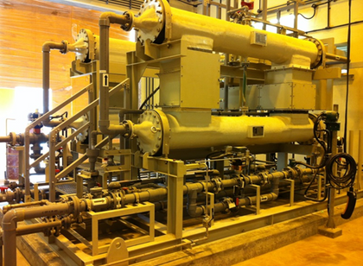
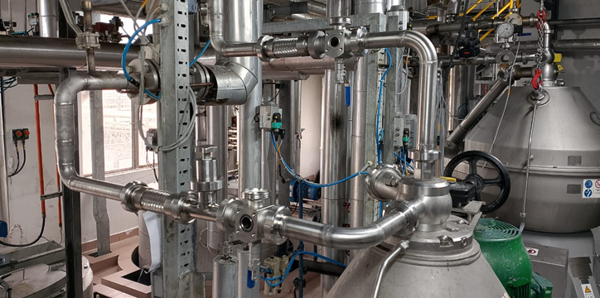
COMPANY PROFILE
Mechanical Contractor based in Johor
(889580-T)
Since 2010
Steel Piping
Non-metallic Piping
Equipment/structure installation
Maintenance & Repair Services
Contact Us
NO. 36, JALAN MUTIARA EMAS 5/11,
TAMAN MOUNT AUSTIN, 81100,
JOHOR BAHRU, JOHOR
TEL: 07-351 3720 FAX: 07-358 7090
sales@accessmne.com.my
Access M&E Services Sdn Bhd

Slide 2
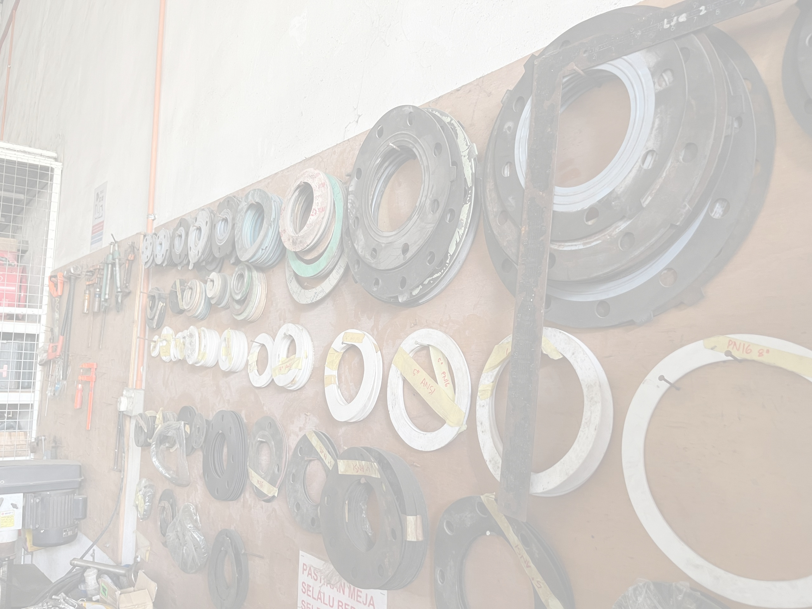
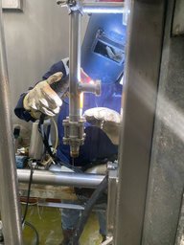
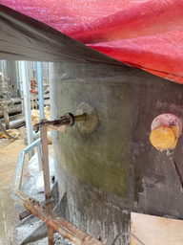
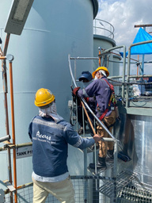
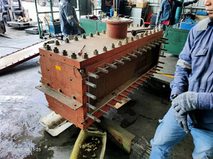
PRODUCT & SERVICES
METAL PIPING
GTAW (TIG)
GMAW (MIG)
SMAW
Hydrostatic and pneumatic testing
NON-METALLIC
Electrofusion (HDPE)
Butt fusion
Socket fusion
Extrusion /Hot air welding
Solvent cement
FRP lining
FRP piping
MATERIAL:
ABS, HDPE, PE, PVC, UPVC, PP, PVDF, FRP
WATER TANK
REPLACEMENT
STRUCTURE
MODIFICATION
Platform
Spiral staircase
GRATING
INSTALLATION
HDG
FRP
EXPANDED METAL
FENCING,
DRAIN COVER
MAINTENANCE & REPAIR SERVICES
LIFTING WORK
VENT
MINOR CIVIL WORK AND INSULATION
AND OTHER can be arranged through our reliable subcontractor network.
Access M&E Services Sdn Bhd

Slide 3
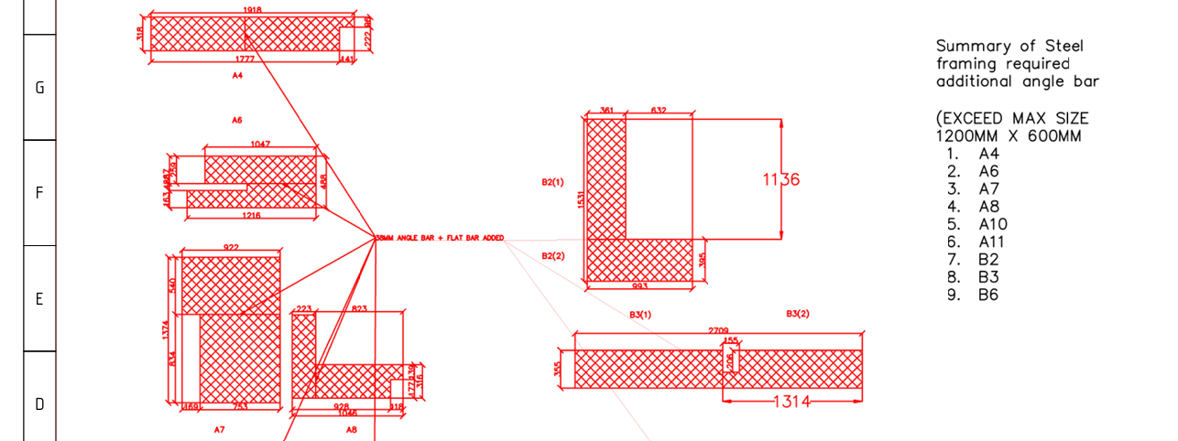
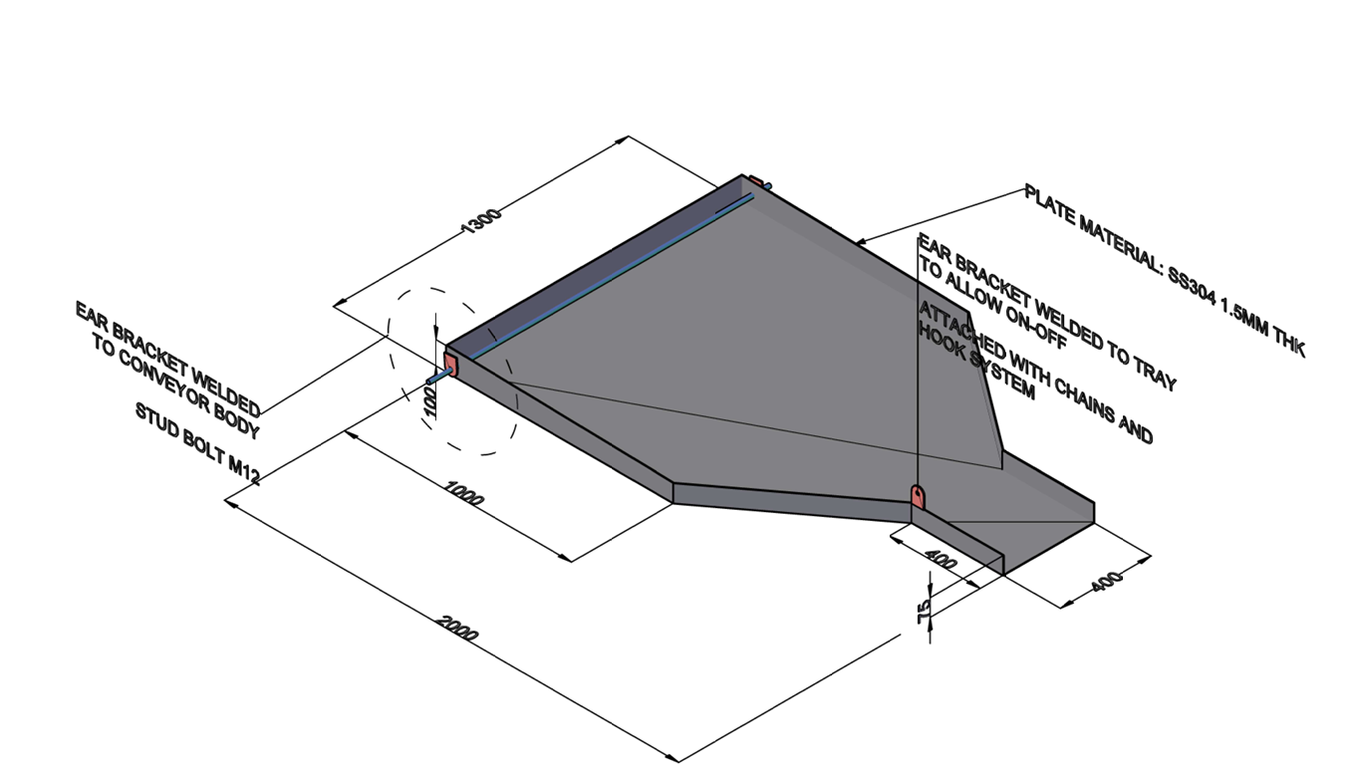
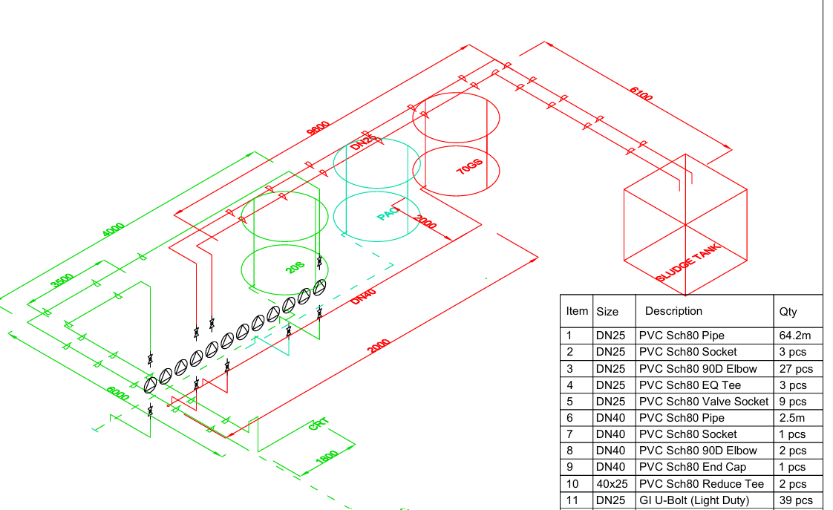
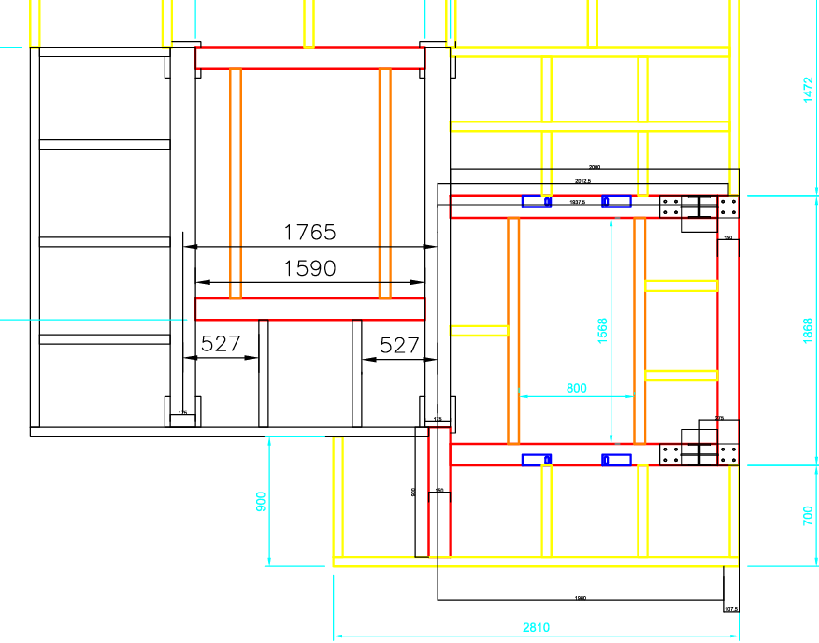
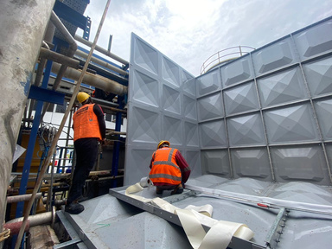
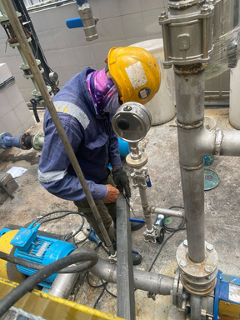
PRODUCT & SERVICES
A TEAM THAT ALWAYS PREPARE
ENGINEER DRAWING
NOT JUST “DOING”,
BUT UNDERSTANDING
AS BUILT/ISO/ P&ID/ 3D
A TEAM THAT UPDATE YOU ON-TIME
DO IT SAFE, DO IT RIGHT, AND DO IT FAST.
MALAYSIAN SUPERVISOR AND FOREMAN
Access M&E Services Sdn Bhd

Slide 4
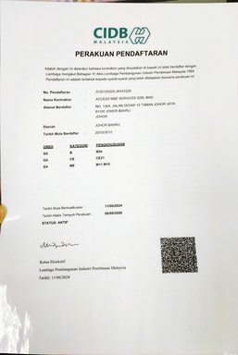
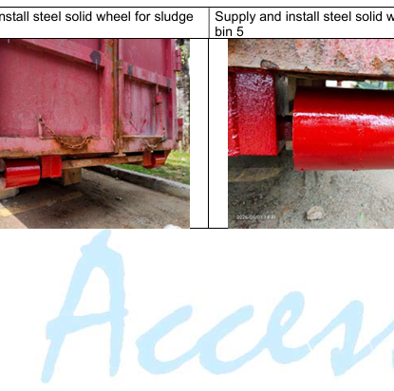
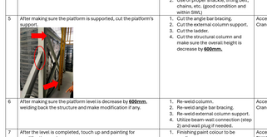
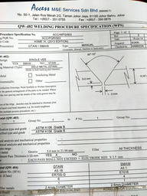
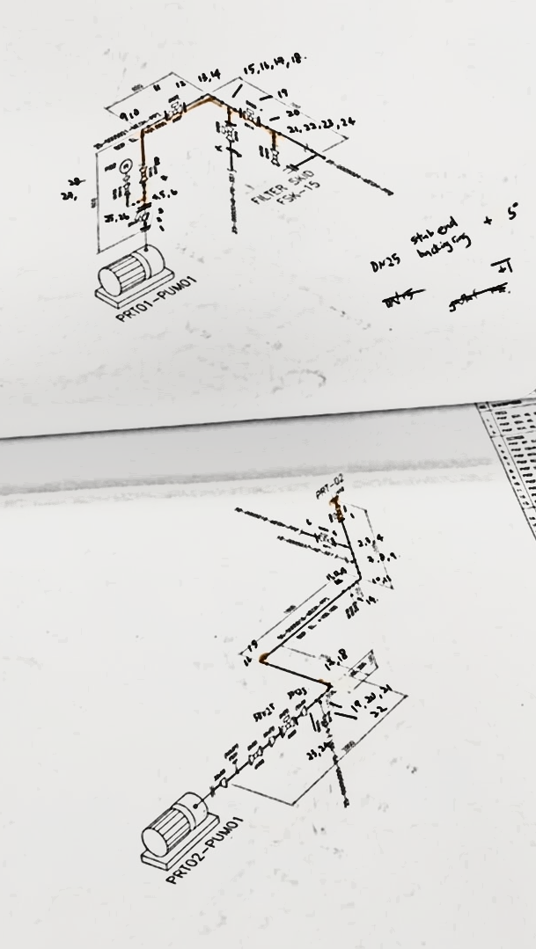
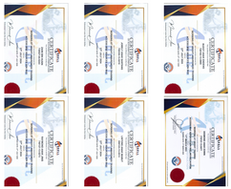
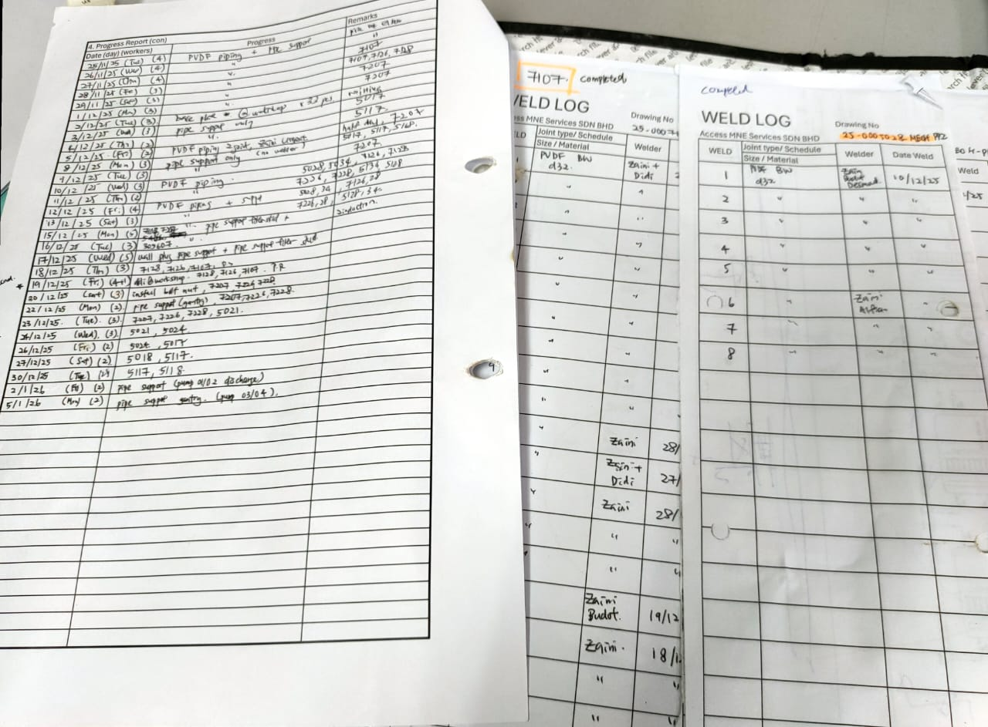
Certificates &
Accreditation
Systematic & Documented
CIDB - G4
B/CE/ME
Work completion report
JSA, MOS and
Permit to Work (PTW)
Welding Procedures Specification (WPS)
Weld map, weld log and progress
Working at Height & Confined Space
Access M&E Services Sdn Bhd

Slide 5
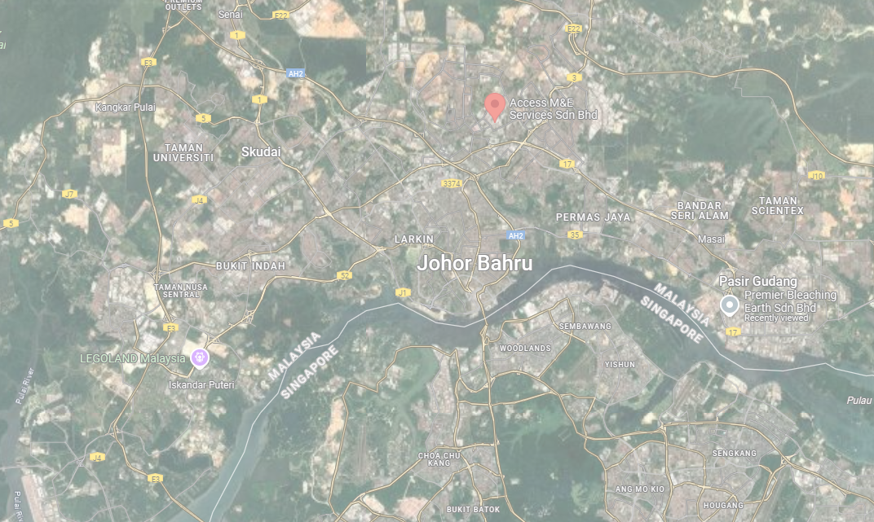
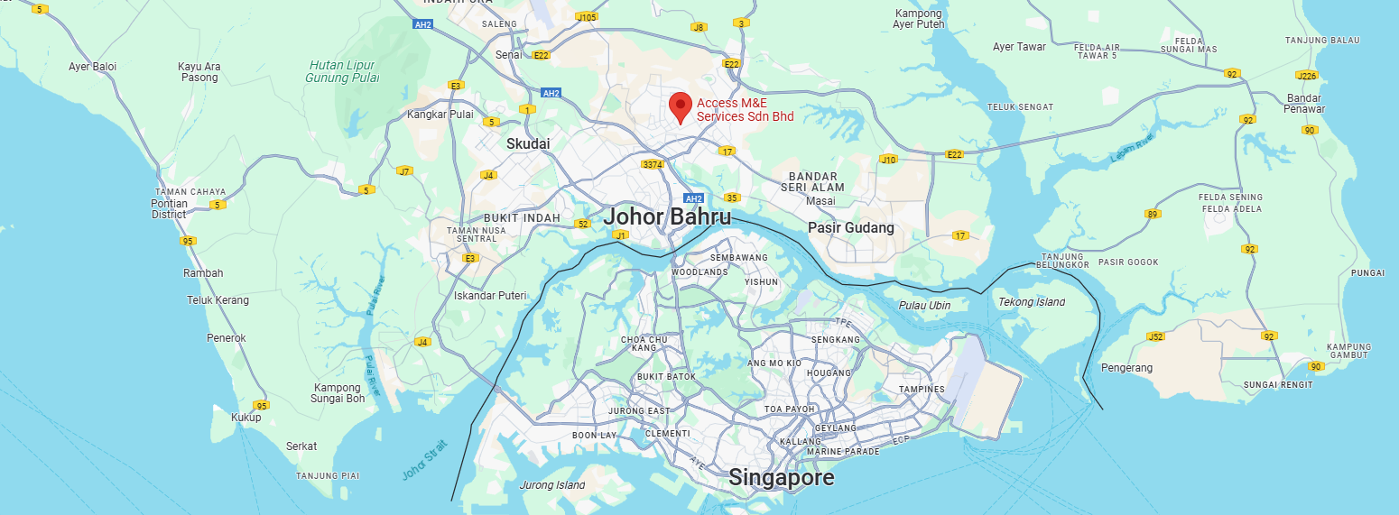

OUR CLIENT
SENAI
Penawar
TAMPOI
PLENTONG
GELANG PATAH
TANJUNG LANGSAT
Johor Bahru
PASIR GUDANG
TANJUNG BIN
AND OTHER PLACES INCLUDING:
SEDENAK, JOHOR
KUANTAN, PAHANG
,ETC.
Access M&E Services Sdn Bhd

Slide 6

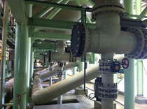
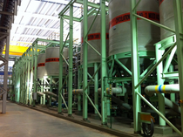
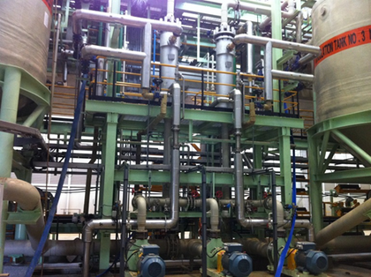
PP piping
Access M&E Services Sdn Bhd

Slide 7
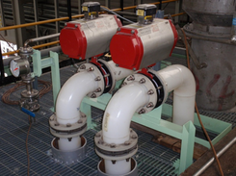
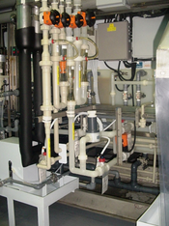
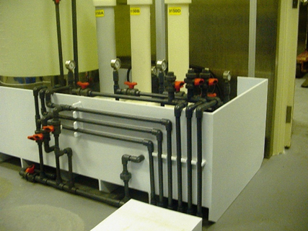
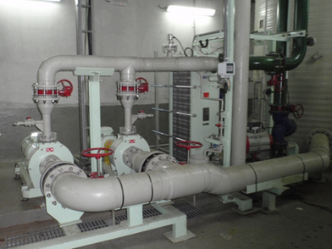
Plastic piping
Access M&E Services Sdn Bhd

Slide 8
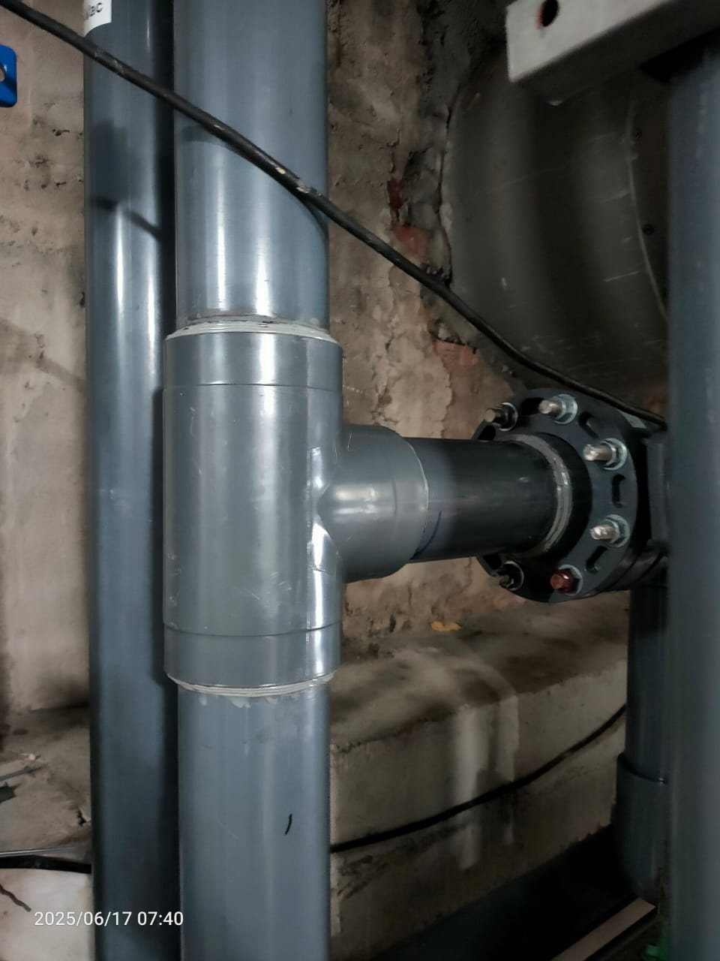
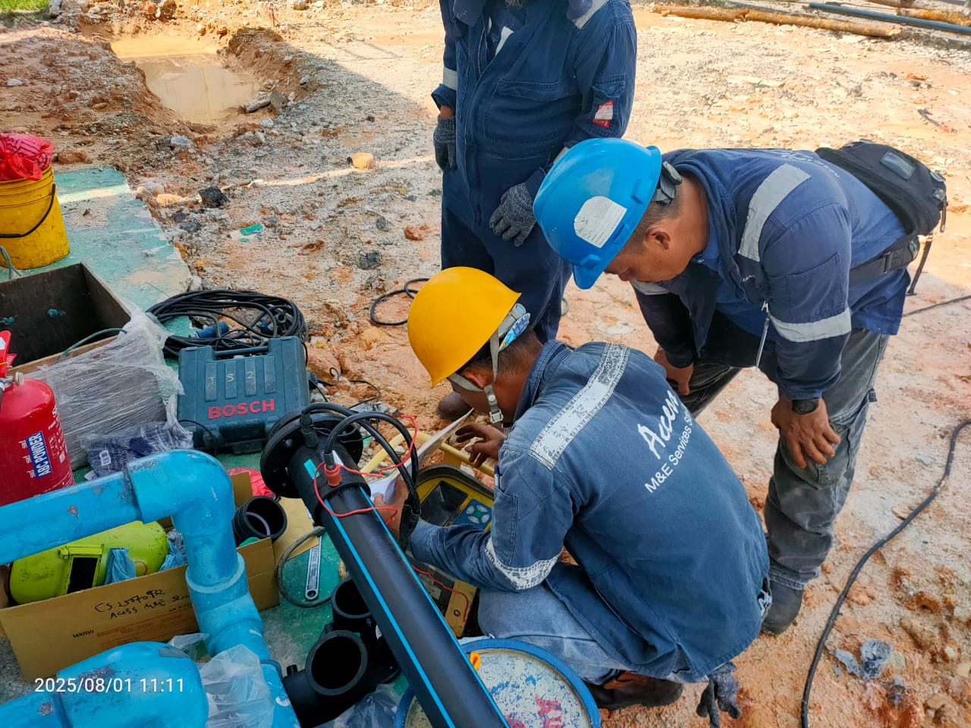
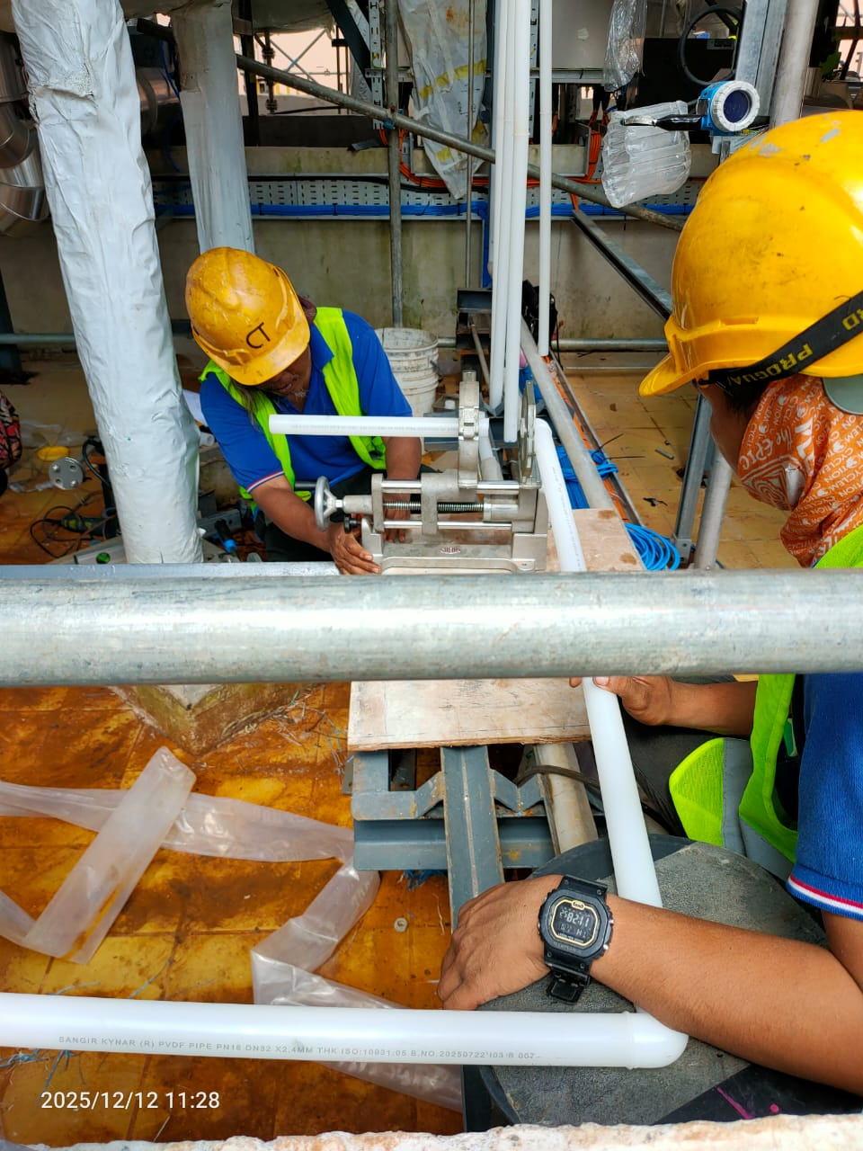
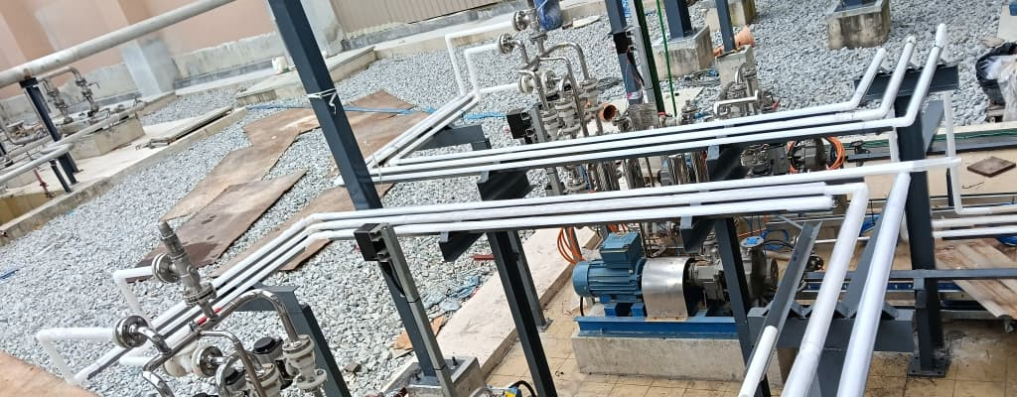
Plastic piping
Access M&E Services Sdn Bhd

Slide 9

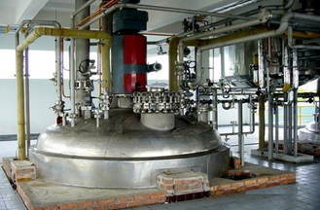
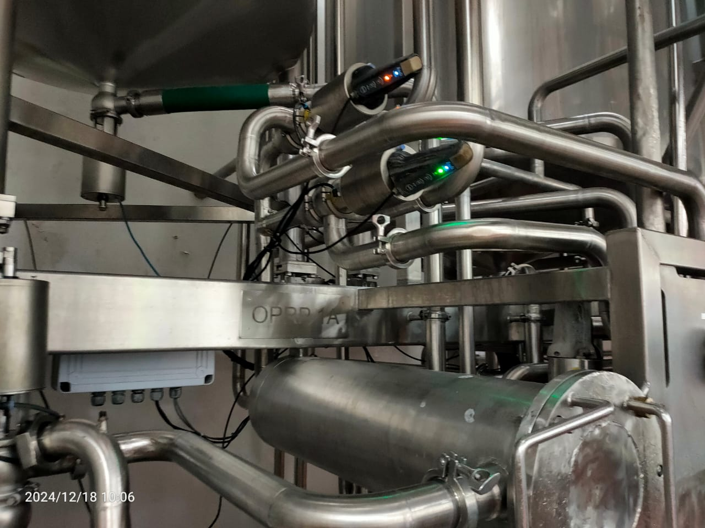
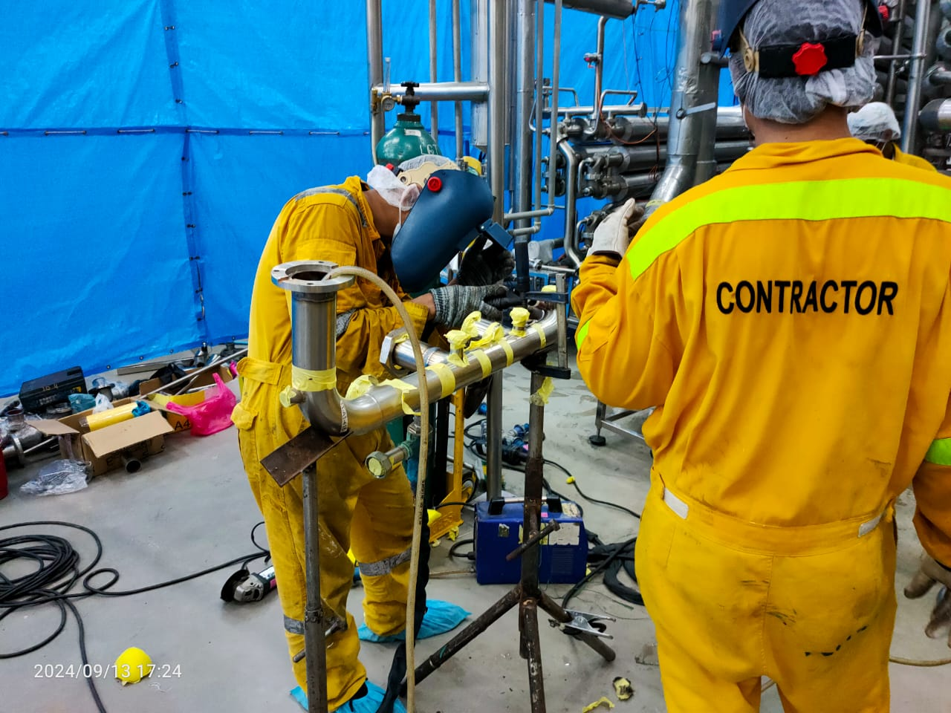
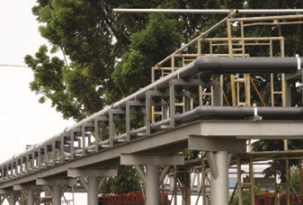
Steel piping
Sanitary piping
Access M&E Services Sdn Bhd

Slide 10
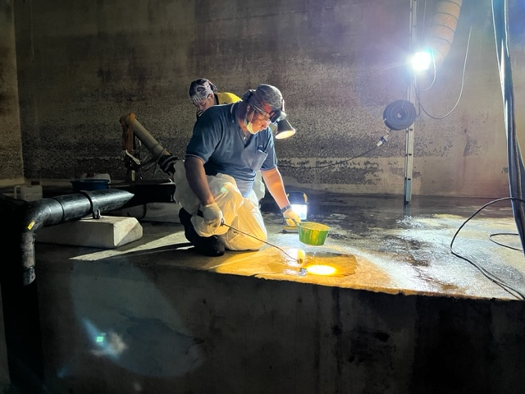
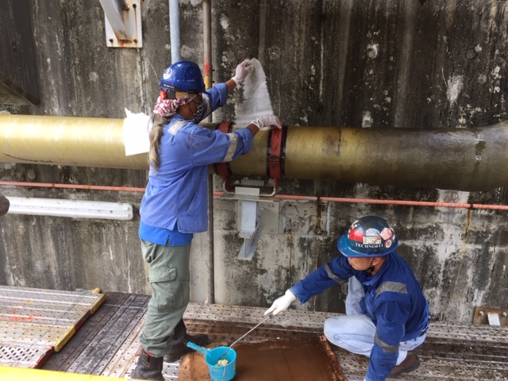
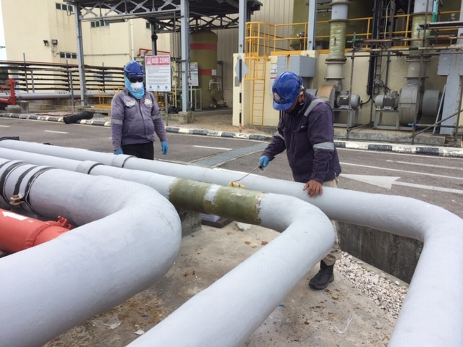
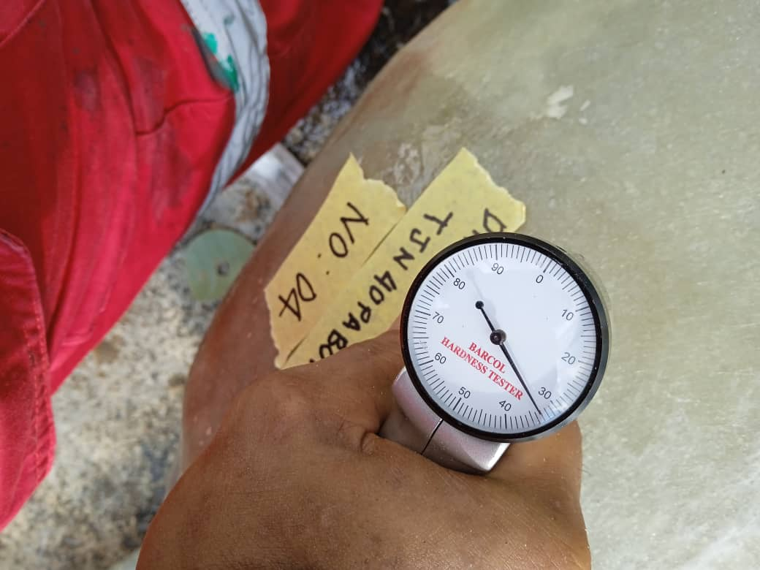
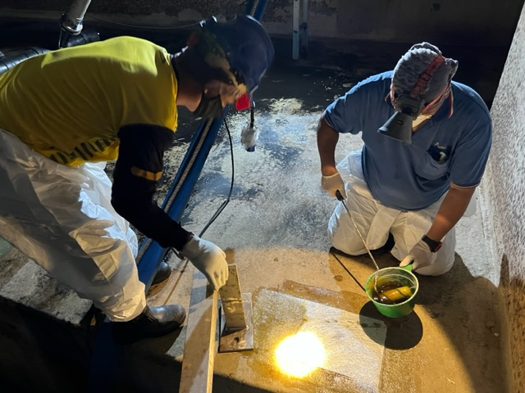
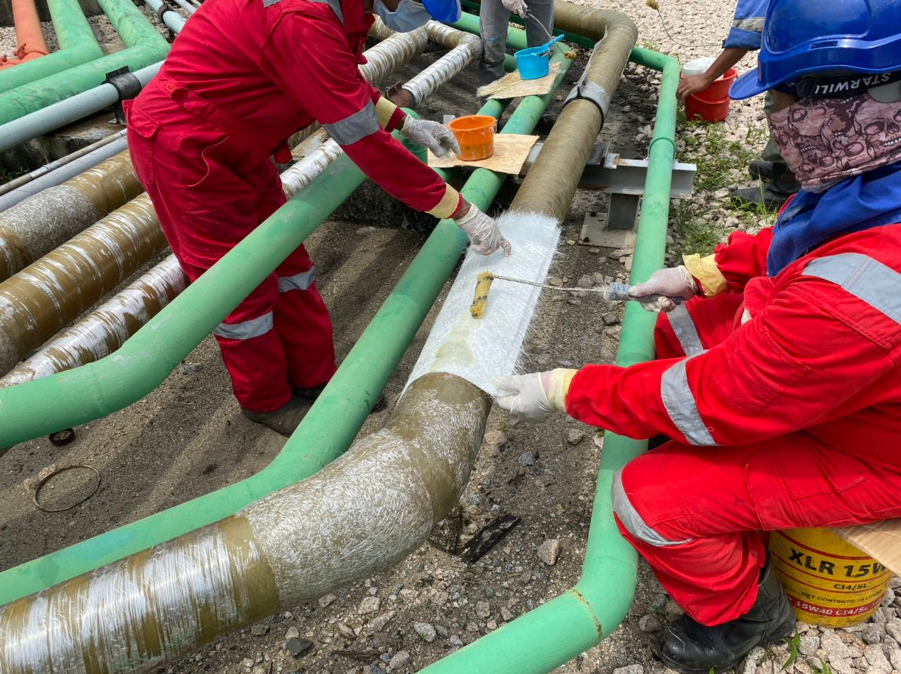
FRP Lining
FRP Piping
Access M&E Services Sdn Bhd

Slide 11


THANK YOU FOR YOUR ATTENTION
Contact Us
NO. 36, JALAN MUTIARA EMAS 5/11,
TAMAN MOUNT AUSTIN, 81100, JOHOR BAHRU, JOHOR
TEL: 07-351 3720 FAX: 07-358 7090
sales@accessmne.com.my

